Slide 1
PowerApps Portals
Ritika Agarwal

Slide 2



RITIKA AGARWAL
Cloud Specialist
Applied Info Services India Pvt Ltd
@Agarwal_ritika
agarwalritika08@gmail.com

Slide 3
Power Apps Portals
Overview
Liquid Programming Language
Demo
Export Portal Configuration Data
XRM Toolbox

Slide 4
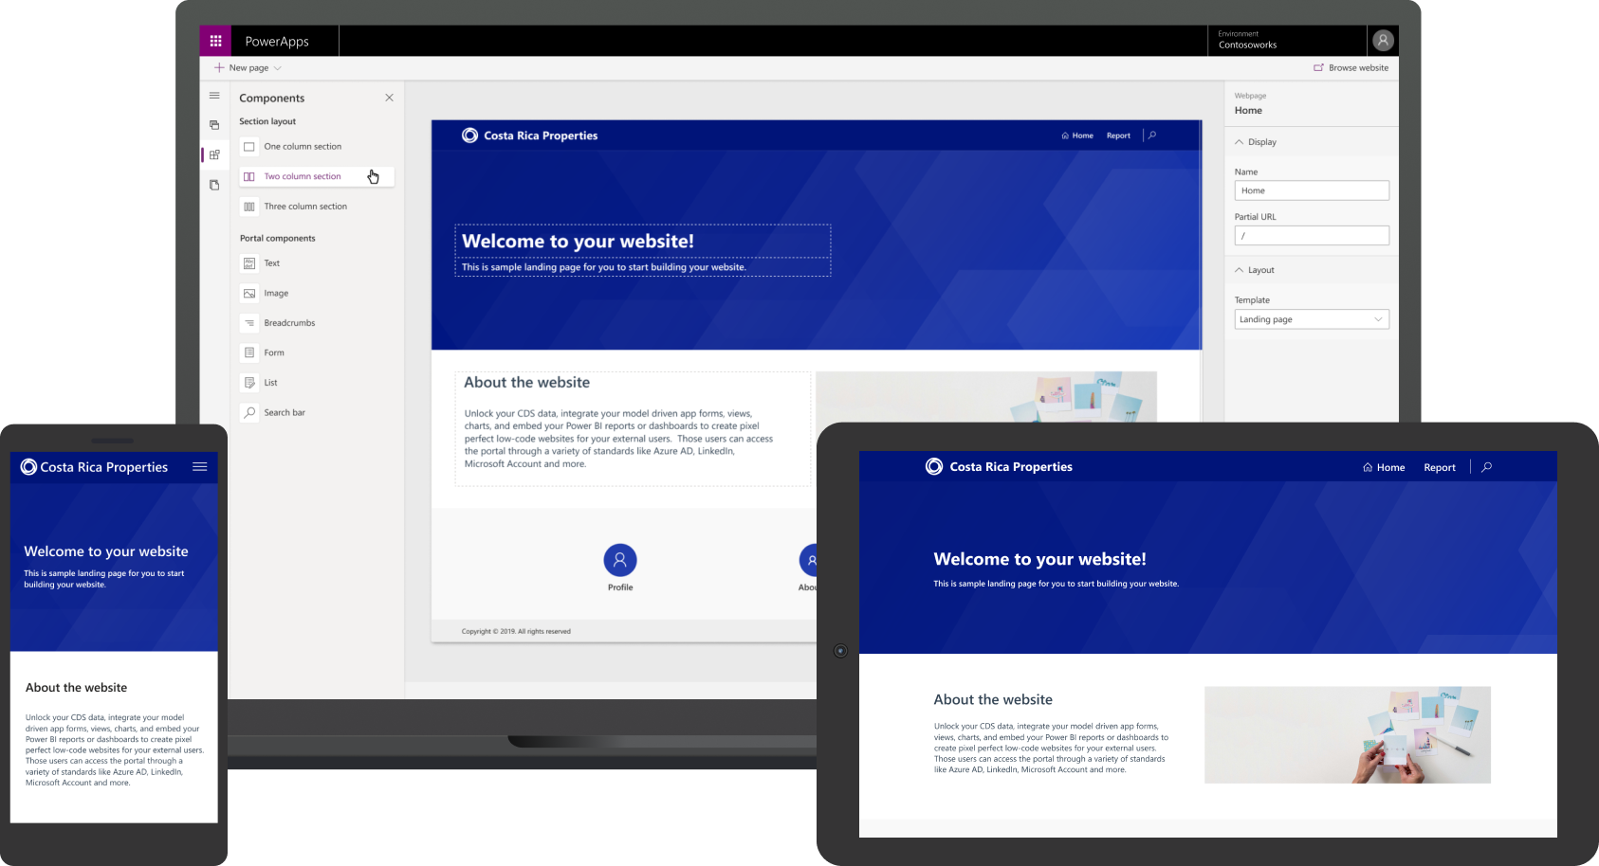
#PowerAppsPortals
Image Source: https://pwrappscdn.azureedge.net/cvt-ed95f8434eef695a4f438461f963027685838e038a8126f54adf82f3e45cf9d5/images/page/powerapps-portals/panel03/panel03_2x.png

Slide 5
Power Apps Portals: Overview
External-Facing Websites
CRUD operations on data in CDS
Entity Permissions
Anonymous Access
Reusable Web Templates
Extend the capability with HTML and Javascript

Slide 6
Liquid Programming Language
Open-Source template language integrated into Portals
Scripts that fetch data from database
Output Dynamic data as HTML content on the Webpages.
Reference: https://docs.microsoft.com/en-us/powerapps/maker/portals/liquid/liquid-objects

Slide 7
Let’s see this in Action

Slide 8


Export Portal Configuration
Export CDS configuration from source to target Environment.
CRM Configuration
Manager
Source Environment
Target Environment
Image Source: https://wpintegrate.com/wp-content/uploads/2018/02/CommonDataModel.jpg | https://uncommonsolutions.com/wp-content/uploads/2018/12/Microsoft-Dynamics-CRM-logo.png

Slide 9

XRM ToolBox
Portal Code Editor
Portal Records Mover
Image Source: https://avatars1.githubusercontent.com/u/10774317?s=400&v=4

Slide 10
Any Questions?

Slide 11

Please fill out the survey! & Win Swags!!
https://www.powerplatformbootcamp.com/survey

Slide 12
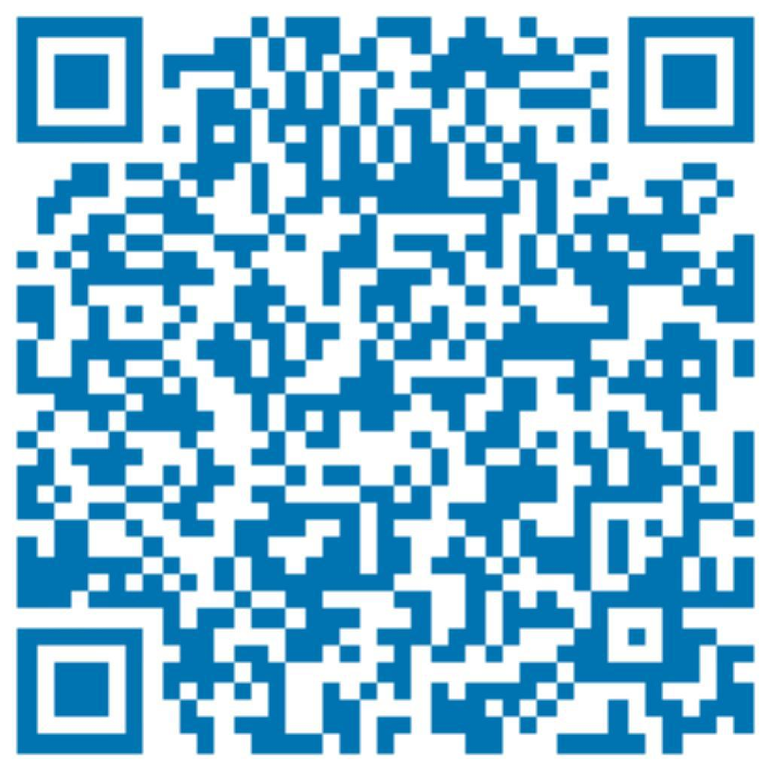
Thank You For Attending
@Agarwal_ritika
agarwalritika08@gmail.com

